Slide 1
Chapter 4: Cellular metabolism
Virtually every task performed by living organisms requires energy extracted from environments (nutrients and/or solar energy). Examples
Assemblage & breakdown of macromolecules
Transport of substances across cell membranes
Transcription & translation of Genetic instructions
Movement, growth, development, reproduction & maintenance of cell/body part
Metabolism refers to all of the chemical reactions that take place inside cells including those that use and release energy

Slide 2
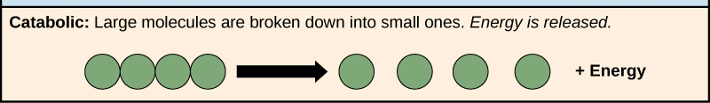
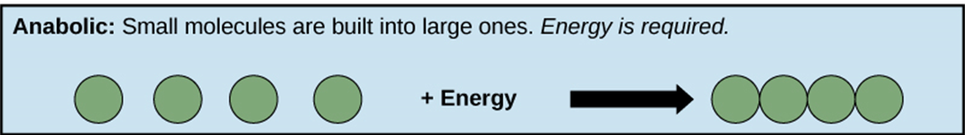
Cellular...
Divided into 2: Anabolism & Catabolism reactions
Catabolic reactions: Degradation reactions
are series of chemical reactions that release energy as polymers are broken down into their monomers
Anabolic reactions: Synthesis Reactions
are series of chemical reactions that require the input of energy to build polymers
Each reaction step in these pathways is catalyzed by a specific enzyme

Slide 3
Enzymes and their role in Metabolism
Enzymes are biological catalysts that increase the rate of chemical reactions without being used up in the process.
Without enzymes, most cellular reactions would take place too slowly to support life
Chemical Nature of Enzymes (Properties)
Most are globular proteins
Enzymes are well suited to their roles in three major ways:
they have enormous catalytic power, they are highly specific in the reactions they catalyze, and their activity as catalysts can be regulated
acts upon reactants called substrates
do not alter the equilibrium constant (Keq).

Slide 4
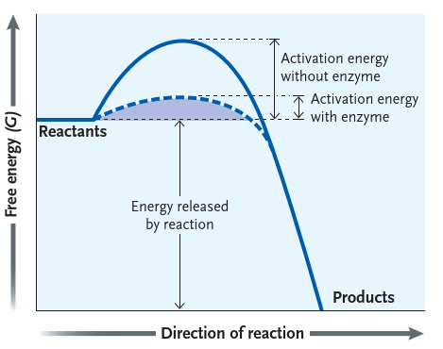
Mechanisms of enzyme action
How enzymes work?
Enzymes accelerates the rate of reaction by decreasing the energy of activation allowing it to achieve equilibrium more rapidly
Activation Energy is the energy required to start a reaction.

Slide 5
Enzyme Classification and Nomenclature
Some of the earliest enzymes to be discovered were given names ending in –into indicate that they were proteins (e.g. the digestive enzymes pepsin, trypsin, chymotrypsin).
Because of the large number of enzymes that are now known, a systematic nomenclature called the Enzyme Commission (EC) system is used to name them. [International Union of Biochemistry and Molecular Biology]

Slide 6
Enzyme Classification and….
EC is a four-digit number. The first digit indicates major class, second digit indicates sub class, third digit denotes sub-sub class and final digit indicates specific enzyme
Enzymes are grouped into six major classes on the basis of the reaction which they catalyze.
Each enzyme has an unambiguous (and often long) systematic name that specifies
  the substrate of the enzyme (the substance acted on)
  the functional group acted on, and
  the type of reaction catalyzed.
All EC names end in ase

Slide 7
Example of systematic name
The enzyme commonly called “hexokinase” is designated “ATP: D-hexose-6-phospho-transferase E.C. 2.7.1.1.” This identifies hexokinase as
    a member of class 2 (transferases)
    subclass 7 (transfer of aphosphoryl group)
    sub-subclass 1 (alcohol is the phos-phoryl acceptor). and
    the term “hexose-6” indicates that the alcohol phosphorylated is that of carbon six of a hexose
Enzymes are also assigned common names derived by adding -ase to the name of the substrate or to a combination of substrate name and type of reaction

Slide 8
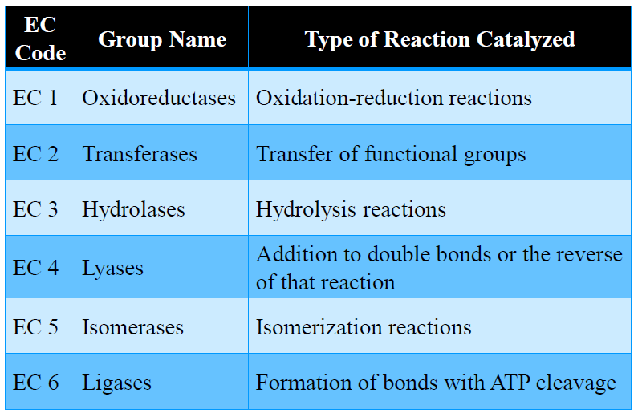
EC Classification of Enzymes

Slide 9
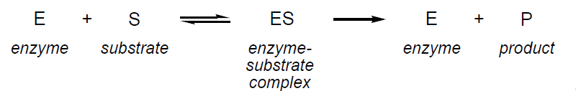
Enzyme-substrate interaction
Substrate interact with enzyme at its active site
The active site
Is a pocket or cleft that is specialized to recognize specific substrates and catalyze chemical transformations.
Substrates bind in active site by weak non-covalent interactions (hydrogen bonding, hydrophobic interactions, ionic interactions)
The interactions hold the substrate in the proper orientation for most effective catalysis

Slide 10
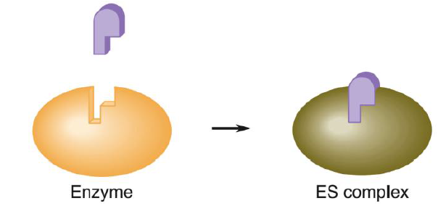
Two models for enzyme/substrate interactions:
1. Lock and Key Model:
Proposed by Emil Fischer in 1894
Explains the high specificity of enzyme activity. Enzyme surfaces accommodate substrates having specific shapes and sizes, so only specific substances ―fit in an active site to form an ES complex
A limitation of this theory is that it requires enzymes conformations to be rigid. Research suggests that instead enzymes are at least somewhat flexible.
This model fails to take into account proteins conformational changes to accommodate a substrate molecule.

Slide 11
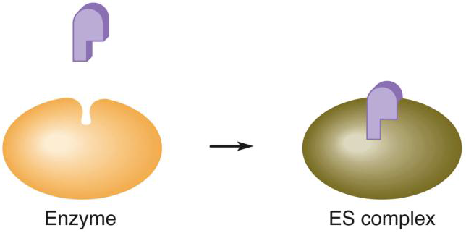
2. In the induced-fit model
Proposed by Daniel E. Koshland in 1958
Proposes that enzymes have flexible conformations that may adapt to incoming substrates.
The active site adopts a shape that is complementary to the substrate only after the substrate is bound

Slide 12
Enzyme Cofactors
Cofactors are non-protein molecules required for activity of some enzymes
There are two types of cofactors:
  Organic cofactors(co-enzymes) such as NAD⁺, FAD⁺ and
  Inorganic cofactors(metal Ions) such as Fe²⁺, Mg^{2+,} Mn²⁺, or Zn²⁺
A coenzyme or metal ion that is very tightly or even covalently bound to the enzyme protein is called a prosthetic group.
Co-enzyme + Apoenzyme = holoenzyme.

Slide 13
Enzyme Kinetics
Refers to the rate of an enzyme-catalyzed reaction
The velocity of all enzymes is dependent on
    Substrate concentration
    Enzyme concentration
    Temperature, and
    pH

Slide 14
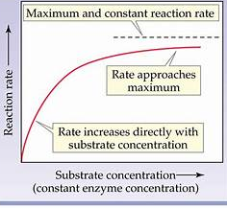
1. Effect of substrate and enzyme concentration
Substrate Concentration
Increasing [S] increases the rate of the reaction, but eventually, the rate reaches a maximum (Vmax), and remains constant after that.
The maximum rate is reached when the enzyme is saturated with substrate, and cannot react any faster under those conditions
The shape of the resulting graph when V₀ is plotted against [S] is called a hyperbolic curve

Slide 15
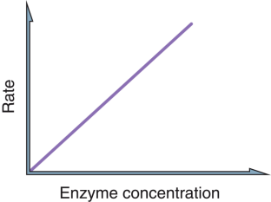
Effect of substrate and enzyme concentration….
Enzyme Concentration
At saturating substrate concentration (i.e. all the enzyme molecules are bound to substrate), a doubling of the enzyme concentration will lead to a doubling of V₀. This gives a straight line graph when V₀ is plotted against enzyme concentration.

Slide 16
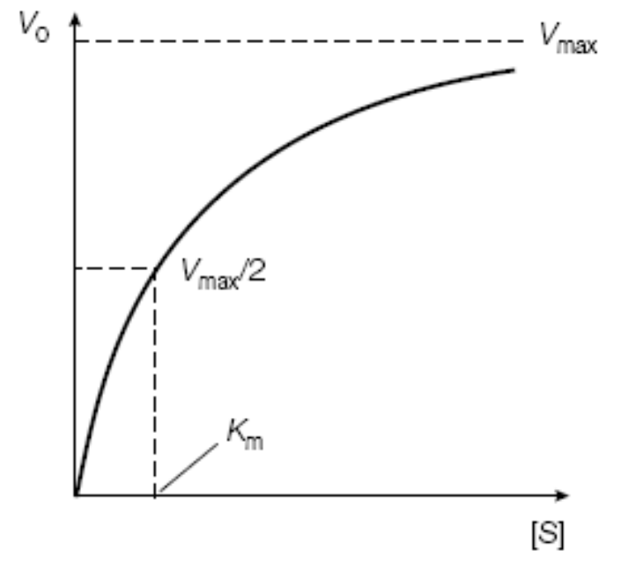
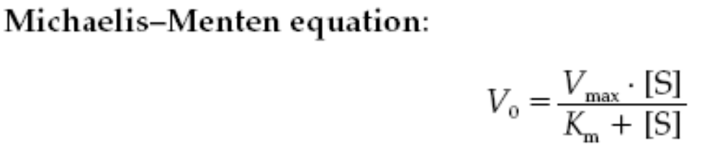
Effect of substrate and enzyme concentration….
The dependence of enzyme rate (activity) on substrate concentration has been provided in a quantitative way.
The simplest of these equations, the Michaelis-Menten equation, relates the initial velocity (V₀) to the concentration of substrate [S] and the two parameters K_{m} and V_{max.}

Slide 17
2. Temperature
Temperature affects the rate of enzyme-catalyzed reactions in two ways.
First, arise in temperature increases the thermal energy of the substrate molecules.
  This raises the proportion of substrate molecules with sufﬁcient energy to overcome energy of activation, and hence increases the rate of the reaction.
a second effect comes into play at higher temperatures.
  Increasing the thermal energy of the molecules increase the chances of breaking the multiple weak, non-covalent interactions which hold the three-dimensional structure of the enzyme together. Ultimately this will lead to the denaturation (unfolding) of the enzyme, decreasing enzyme activity

Slide 18
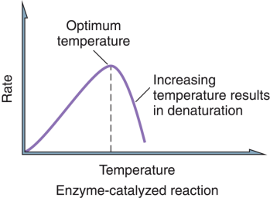
3. pH
Each enzyme has an optimum pH at which the rate of the reaction that it catalyzes is at its maximum.
Slight deviations in the pH from the optimum lead to a decrease in the reaction rate.
  Larger deviations in pH lead to denaturation of the enzyme due to changes in the ionization of amino acid residues and the disruption of non covalent interactions.

Slide 19
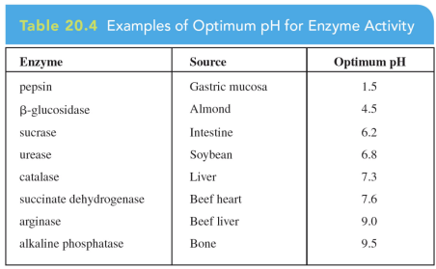
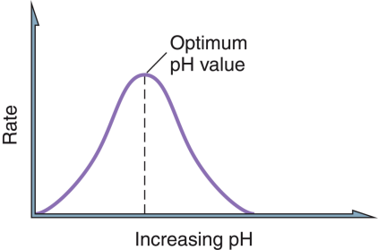
Many enzymes have a pH optimum of around 6.8, but there is great diversity in the pH optima of enzymes, due to the different environments in which they are adapted to work. For example, the digestive enzyme pepsin is adapted to work at the acidic pH of the stomach (around pH 2.0).

Slide 20
Enzyme inhibition
Any substance that can diminish the velocity of an enzyme-catalyzed reaction is called an inhibitor
Many poisons and medicines inhibit one or more enzymes and thereby decrease the rate of the reactions they carry out.
Some substances normally found in cells inhibit specific enzymes, providing a means for internal regulation of cell metabolism.
Enzyme inhibition can be of two main types:
    irreversible or
    reversible.
Reversible inhibition can be subdivided into
    competitive and
    noncompetitive

Slide 21
1. Irreversible Inhibitors
Inhibitor forms a covalent bond with a specific functional group of an enzyme, thereby inactivating it. Also called suicide inhibitors
  e.g. Cyanide ion, CN-, is a rapidly-acting, highly toxic inhibitor, which interferes with the iron-containing enzyme cytochrome oxidase: Cell respiration stops, and death occurs within minutes
Antibiotics are enzyme inhibitors that act on life processes that are essential to certain strains of bacteria
  Penicillin interfere with transpeptidase, which is used by bacteria for the construction of cell walls.

Slide 22
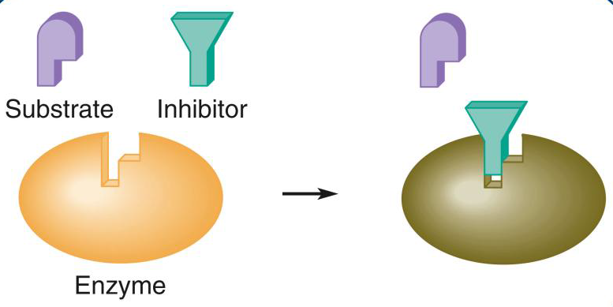
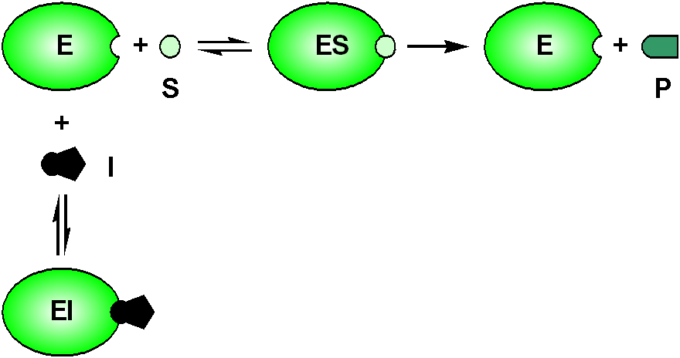
2. Reversible Inhibitors
Once the inhibitor combines with the enzyme by non-covalent interaction, the active site is blocked, and no further catalysis takes place. E + I EI
a. Competitive inhibitors
Competitive inhibitors bind to the enzyme’s active site and compete with the normal substrate molecules. They often have structures that are similar to those of the normal substrate
Can be overcame by increasing [S]

Slide 23
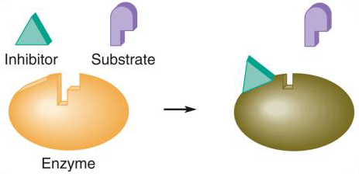
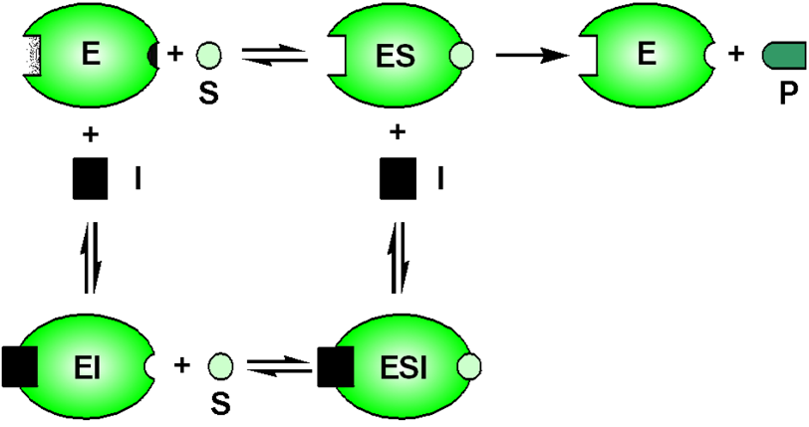
b. Non-competitive inhibitors
Noncompetitive inhibitors bind reversibly to the enzyme at a site other than the active site, changing the 3D shape of the enzyme and the active site, so that the normal substrate no longer fits correctly.
Noncompetitive inhibitors do not look like the enzyme substrates.
Increasing the substrate concentration does not affect noncompetitive inhibition because it can’t bind to the site occupied by the inhibitor

Slide 24
Enzyme regulation
The rates of enzyme-catalyzed reactions are altered by activators and inhibitors (a.k.a. effector molecules).
Allosteric enzymes: have more than one site, where effector binding at one site induces a conformational change in the enzyme, altering its affinity for a substrate.
  An allosteric activator increases enzyme rate of activity,
  An allosteric inhibitor decreases its activity.

Slide 25
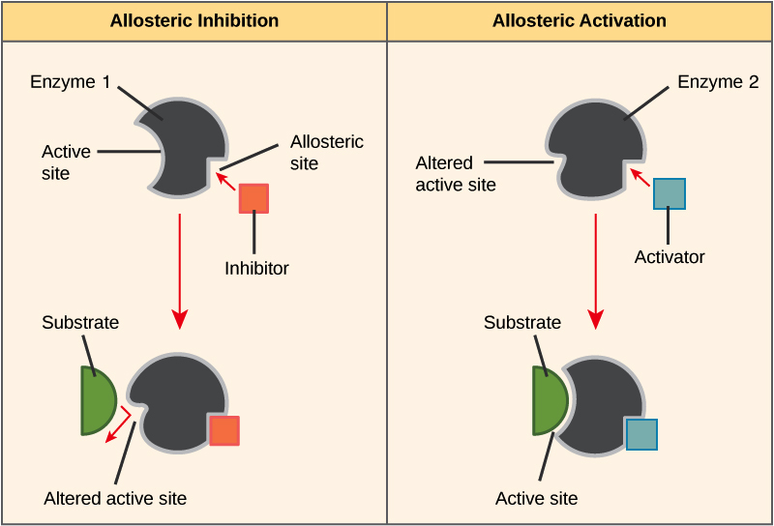

Slide 26
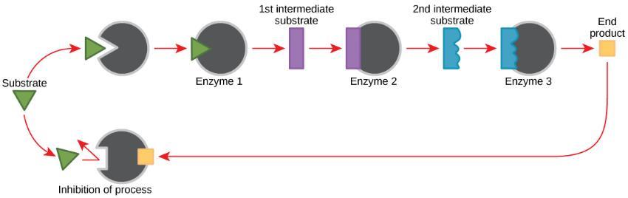
2. Feedback regulation
Feedback inhibition is the inhibition of an enzyme by the reaction product.
an enzyme early on in the pathway is inhibited by an end-product of the metabolic pathway in which it is involved

Slide 27
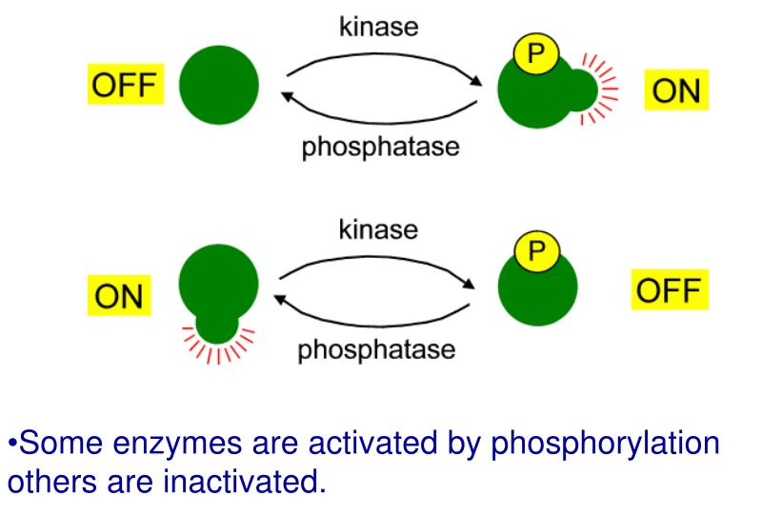
Reversible covalent modiﬁcation
The activity of many enzymes is altered by the reversible making and breaking of a covalent bond between the enzyme and a small non-protein group(Phosphorylation, Methylation, Glycosylation…etc)

Slide 28
Regulation of enzyme activity….
3. Proteolytic cleavage
Zymogens or proenzymes are inactive precursors of an enzyme.
Some enzymes in their active form would degrade the internal structures of the cell. These enzymes are synthesized and stored as inactive precursors, and when the enzyme is needed, the zymogen is released and activated where it is needed.
Activation usually requires the cleavage of one or more peptide bonds.
The digestive enzymes pepsin, trypsin, and chymotrypsin, as well as enzymes involved in blood clotting, are activated this way.

Slide 29
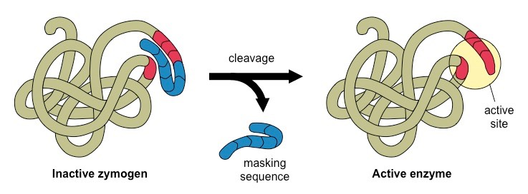
Regulation of enzyme activity….
Example: Trypsin and Chymotrypsin
Initially synthesized as trypsinogen and chymotrypsinogen which are both inactive
Formed in the pancreas where they would do damage if active
In the small intestine, where their digestive properties are needed, they are activated by cleavage of specific peptide bonds by entropeptidase

Slide 30
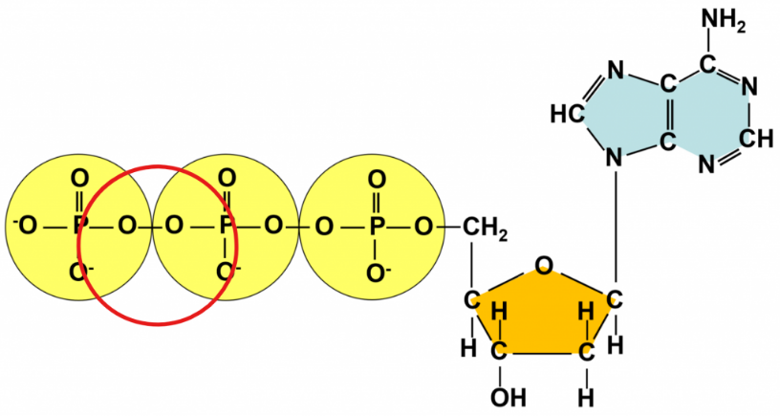
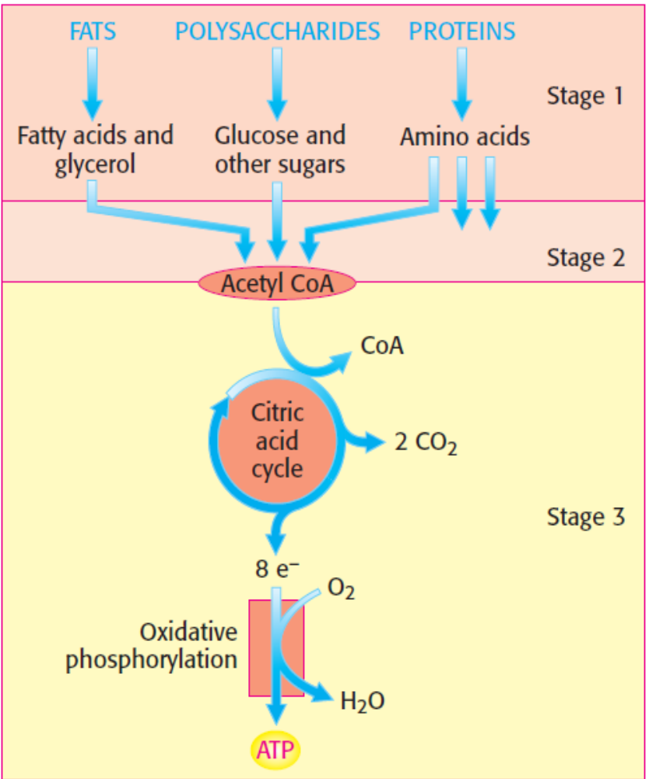
Cellular Respiration
Is a series of chemical reactions that breakdown biomolecules to release energy (ATP)
Stage1: Digestion of larger molecules to smaller molecules
Stage 2: Conversion of products of digestion to acetyl CoA
Stage 3: the citric acid cycle
Stage 4: Electron transport chain and oxidative phosphorylation produce ATP
Stage 4

Slide 31
Three major mechanisms of ATP biosynthesis.
Substrate level phosphorylation as in Glycolysis
  Chemical reaction coupled to ATP synthesis
Oxidative phosphorylation in cellular respiration and
  Pumping of protons powered by electron transport with oxygen as terminal electron acceptor yields ATP
Photophosphorylation in photosynthesis
  Pumping of protons powered by absorption of light.

Slide 32
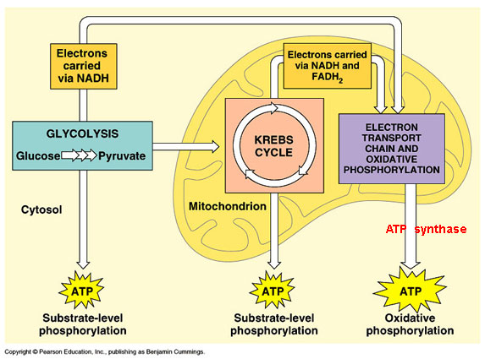
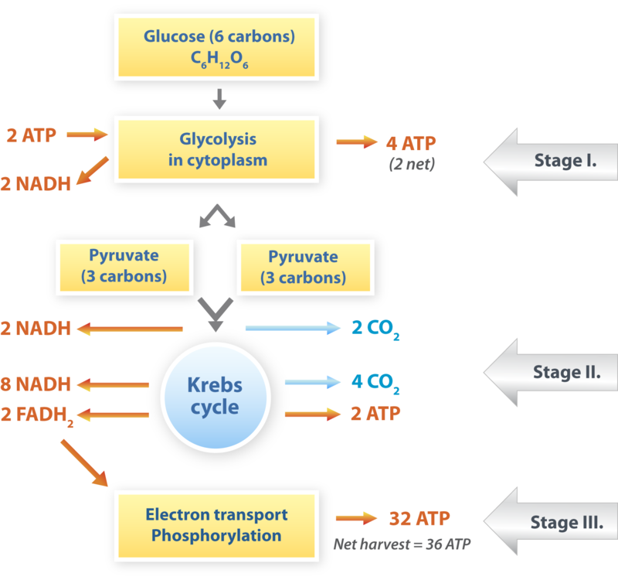
Cellular respiration = Glycolysis + Krebs Cycle + Electron Transport Chain

Slide 33
Cellular respiration…..
Glycolysis- Embden-Meyerhof-Parnas pathway)
converts one molecule of glucose to two molecules of pyruvate while generating ATP.
the major source of energy for anaerobic microorganisms
takes place in the cytosol of cells
some tissues, such as the brain and red blood cells, rely solely on glucose as a fuel; consequently, glycolysis is especially important in these tissues.

Slide 34
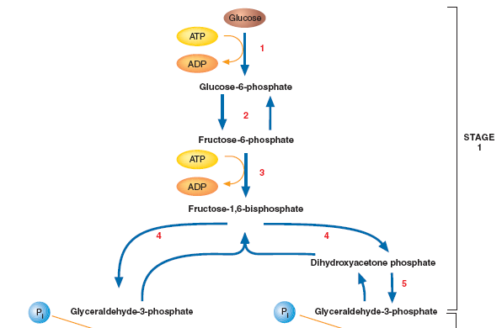
Glycolysis: divided into two stages (each with 5 steps)
Stage I. Energy Investment Phase
Glucose is phosphorylated twice and cleaved to form two molecules ofglyceraldehyde-3-phosphate (G-3-P).
The two ATP molecules consumed during this stage are like an investment, because this stage creates the actual substrates for oxidation in a form that is trapped inside the cell

Slide 35
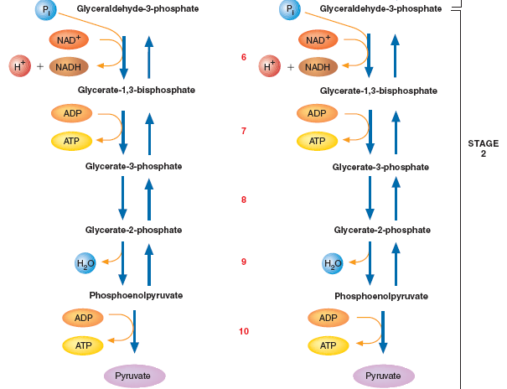
Stage II: Energy payoff phase
Convert Glyceraldehyde-3 phosphate to pyruvate.
Generate four ATP and two NADH molecules
Because two ATP were consumed in stage1, the net production of ATP per glucose molecule is 2

Slide 36
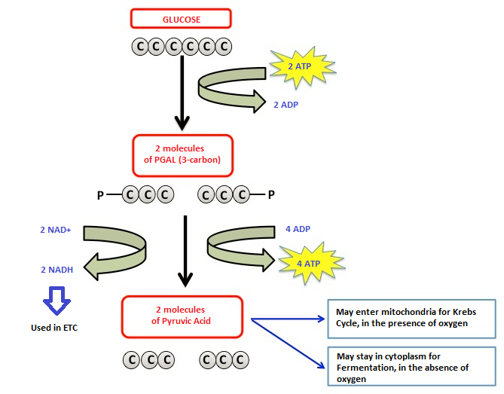
Glycolysis….
Overall, glycolysis
generates two molecules of NADH (nicotinamide adenine dinucleotide) and two molecules of ATP
produce intermediates that act as precursors for a number of biosynthetic pathways .
For example acetyl CoA is the precursor for fatty acid synthesis
The glycolytic pathway can be summed up in the following equation:
Glucose + 2 ADP + 2 Pi + 2 NAD⁺→2 pyruvate + 2 ATP + 2 NADH + 2H + 2H₂O

Slide 37
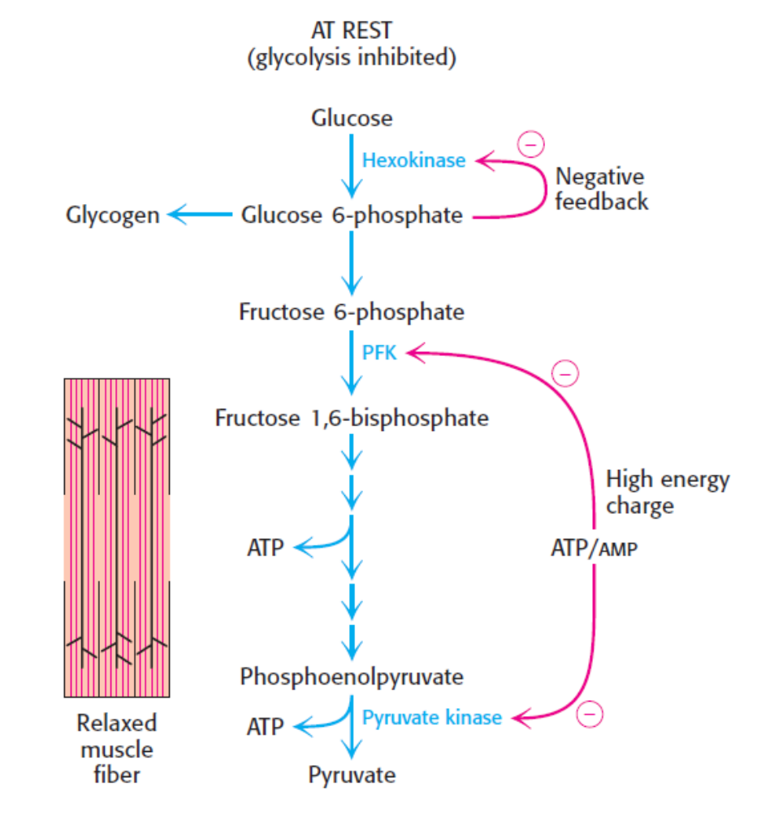
Regulation of glycolysis
Glycolysis is regulated by, feedback inhibition
  high levels of ATP inhibit the enzyme
  phosphofructokinase early in the pathway
  As more G-6-P produced, the rxn rate slow down
  Hexokinase governs rate limiting steps in

Slide 38
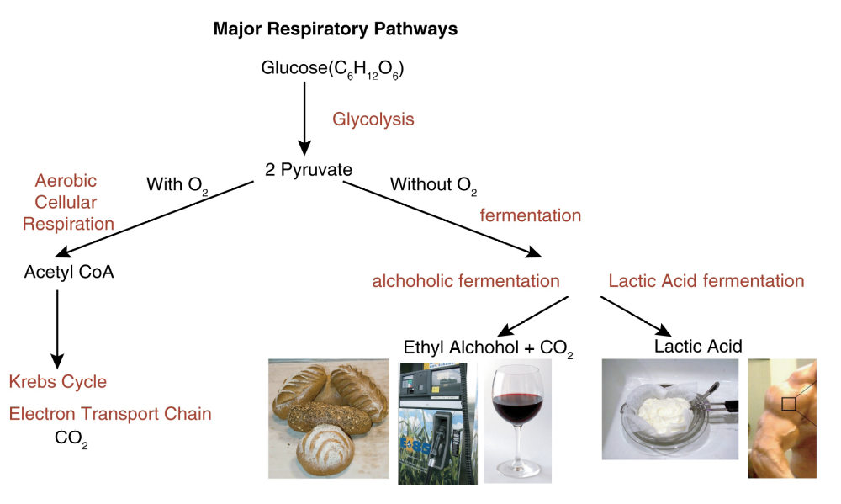
Fates of pyruvate

Slide 39
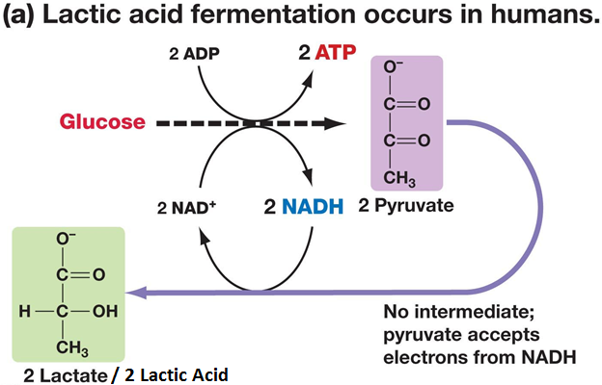
Lactic acid fermentation
When oxygen is limiting in muscle during vigorous exercise, pyruvate is converted into lactate by lactate dehydrogenase
Regenerates NAD^{+,} Ensures the continuation of the process of glycolysis
Under aerobic conditions, NAD+ is regenerated by re-oxidation of NADH via the electron transport chain.
Skeletal muscles ferment glucose to lactate during exercise= Results in muscle fatigue
Lactate released to the blood may be taken up by other tissues, or by skeletal muscle after exercise, and converted via Lactate Dehydrogenase back to pyruvate

Slide 40
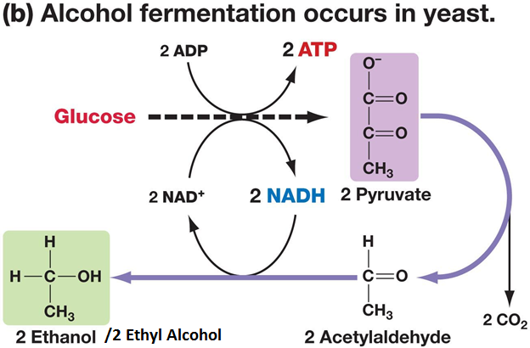
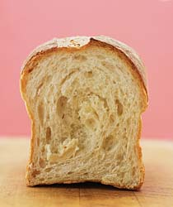
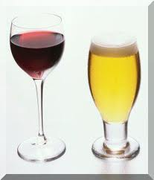
Alcoholic fermentation
pyruvate is converted to acetaldehyde (by pyruvate decarboxylase) and then to ethanol (by alcohol dehydrogenase)
Produce CO₂ as byproduct
Also regenerates NAD+
Example: yeast

Slide 41
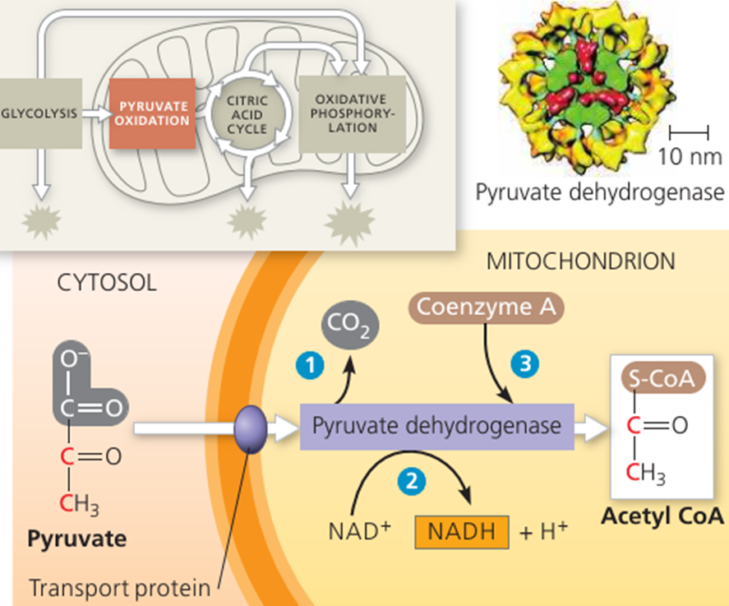
The Kreb Cycle/tricarboxylic acid cycle/ citric acid cycle
named after Hans Krebs
Consists of series of eight steps of reactions
take place in mitochondria
If oxygen is available, the pyruvate molecules produced at the end of glycolysis are transported into the mitochondria via a pyruvate/H⁺ symport.
Within the mitochondria, pyruvate is oxidatively decarboxylated to acetyl-CoA. This reaction is catalyzed by several different enzymes working sequentially in a multi-enzyme complex collectively known as the pyruvate dehydrogenase complex.

Slide 42
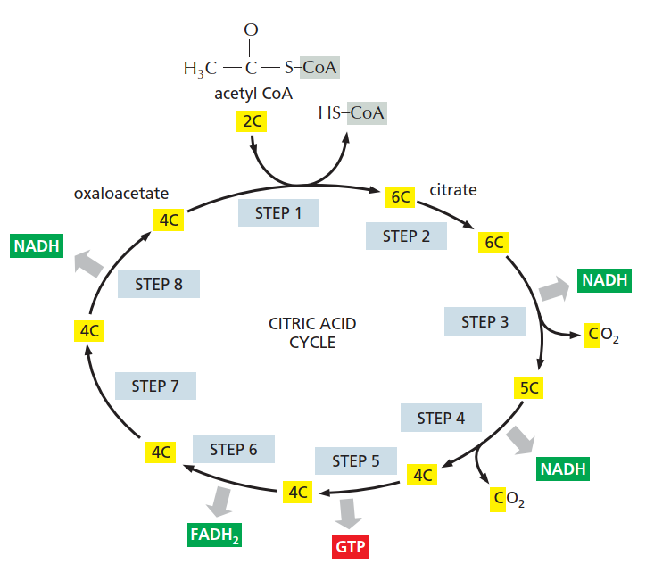
Kreb cycle....
The acetyl groups are fed into the citric acid cycle, which enzymatically oxidizes them to CO₂.
The energy released by oxidation is conserved in the reduced electron carriers NADH and FADH2
The reduced coenzymes are then oxidized to protons and electrons.
The electrons are transferred, eventually, to O2, via a chain Electron transport system.

Slide 43
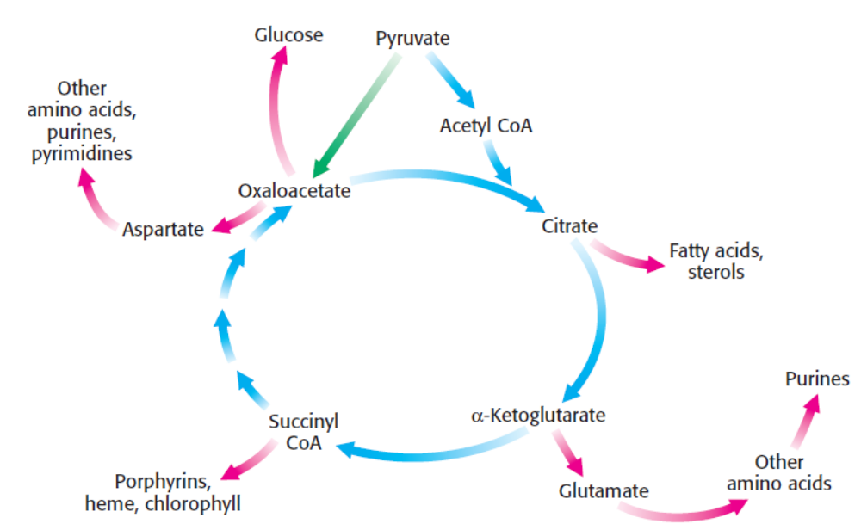
Role of TCA cycle
acts as a final common pathway for the oxidation of carbohydrate, lipids, and protein
  glucose, fatty acids, and many amino acids can all be metabolized to acetyl-CoA or intermediates in the cycle.

Slide 44
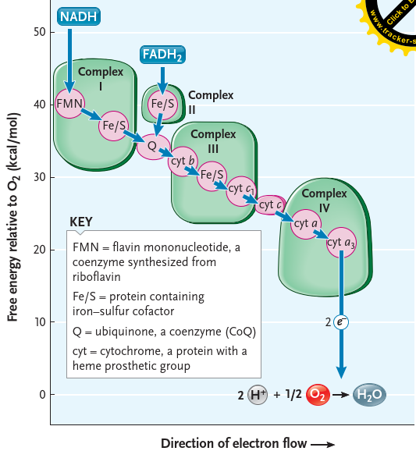
The Electron Transport Chain (ETC)
Series of electron carriers that transfer electrons captured in the form of NADH and FADH₂ molecules during glycolysis, pyruvate oxidation and TCA cycle to O₂ (the final electron acceptor).
components of ETC are arranged according to their increasing redox potential (affinity to gain electron)
Electrons flow down an energy gradient from NADH and FADH2 to O2 catalyzed by four protein complexes (Complex I - IV)
occurs in the inner mitochondrial membrane
is the major source of ATP in aerobic organisms
ATP is formed as a result of the transfer of electrons to O₂ through oxidative phosphorylation.

Slide 45
Mechanisms of ATP synthesis (chemiosmotic coupling)
The process of electron transfer is coupled to ATP synthesis
Most of the free energy from the transfer of electrons from NADH or FADH₂ to O2 through ETC pump protons out of the matrix across the inner mitochondrial membrane into the intermembrane space generating a charge separation (Proton motive force (PMF)) across the membrane.
The PMF in the intermembrane space drives the synthesis of ATP as protons flow back from the intermembrane space to the matrix of the mitochondria
These protons are channeled through an enzyme called ATP synthase which catalyzes the formation of ATP from ADP and Pi (a process known as chemiosmosis).

Slide 46
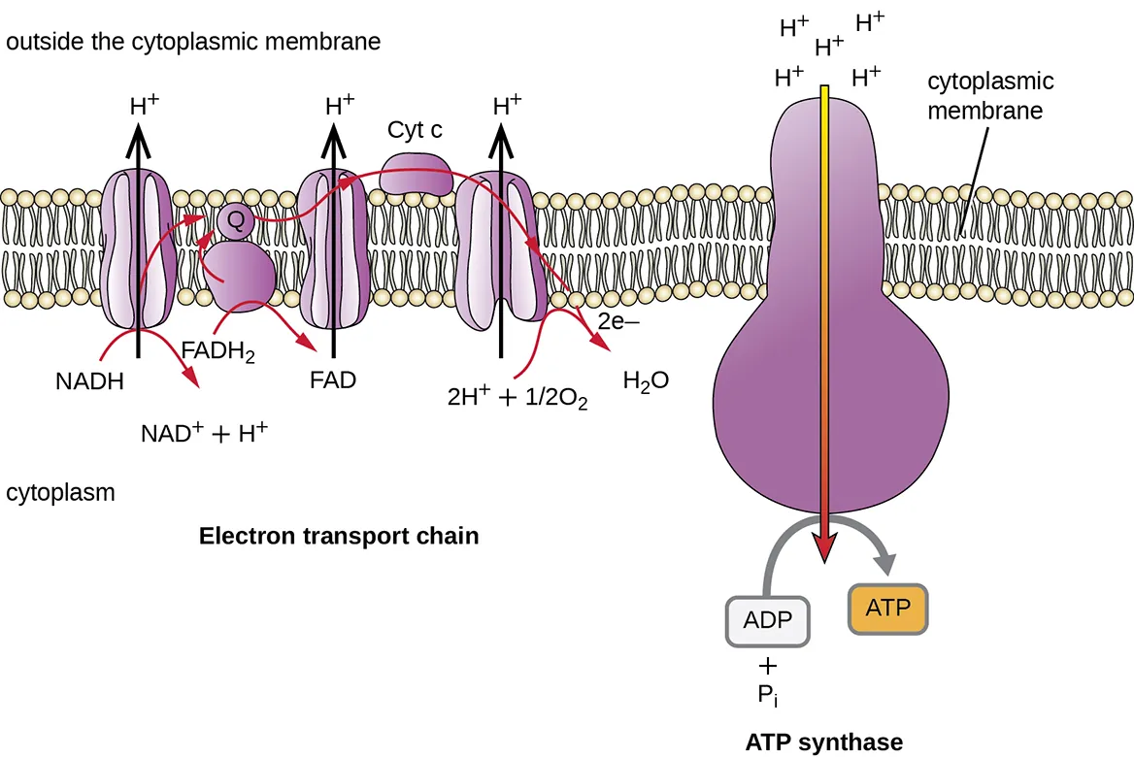

2.5 ATPs are produced from oxidation of 1 NADH and
1.5 ATPs from 1 FADH2

Slide 47
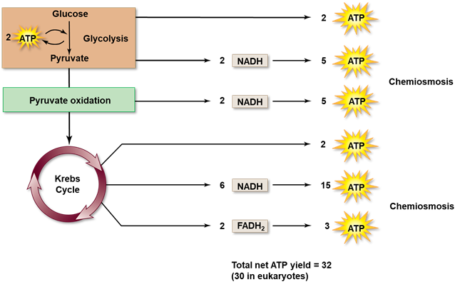
Energy Yield of Respiration
Theoretical energy yield (these values vary from book to book); 36-38 ATP per glucose
Actual energy yield: 30 ATP per glucose for eukaryotes, 32 ATP per glucose for prokaryotes.
Reduced yield is due to “Leaky” inner membrane
Use of the proton gradient for purposes other than ATP synthesis

Slide 48
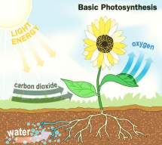
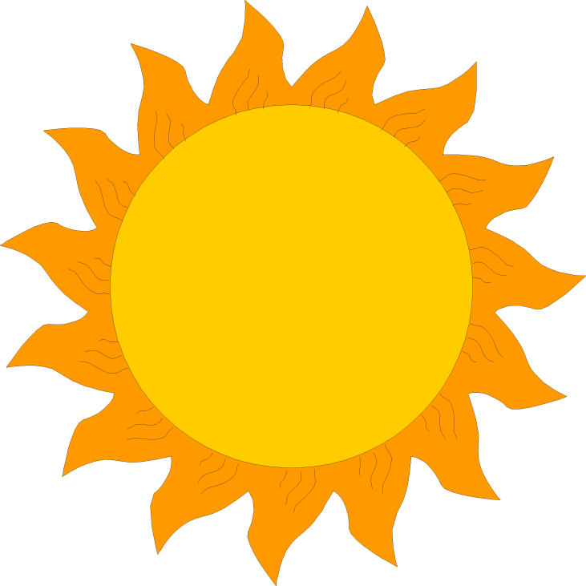
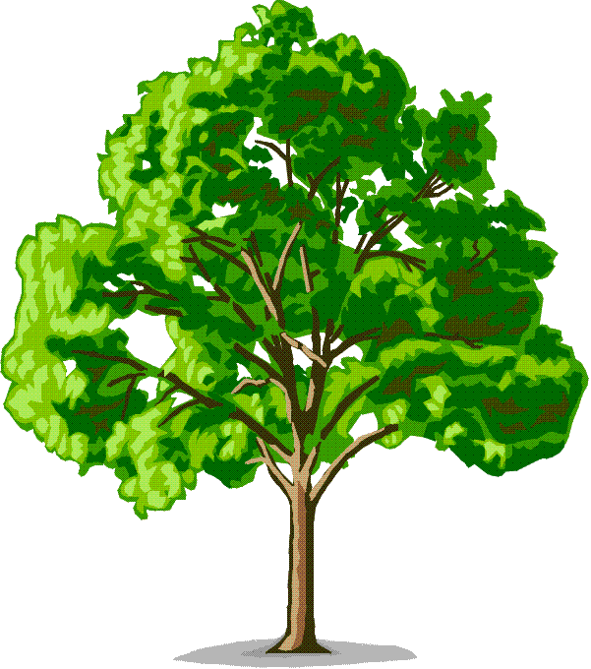
Photosynthesis
Sunlight plays a bigger role in our lives than you may think. All the food we eat and the fossil fuels we burn are products of photosynthesis.
In photosynthesis, plants turn solar energy into chemical bond energy ( food)
Photosynthesis is the process that converts solar energy into chemical energy that is used by biological systems (that means us).

Slide 49
Photosynthesis has 3 major events:
Sunlight is converted into chemical energy
Water (H₂O) is split into oxygen (O₂)
Carbon dioxide (CO₂) is fixed into sugars (C₆H₁₂O₆)
The photosynthesis reaction:
6 CO₂ + 12 H₂O + sunlight → C₆H₁₂O₆ + 6 H₂O + 6 O₂
6 Carbon
dioxide
molecules
1 Sugar
(glucose)
molecule
6 Water
molecules
12 Water
molecules
6 Oxygen
molecules

Slide 50
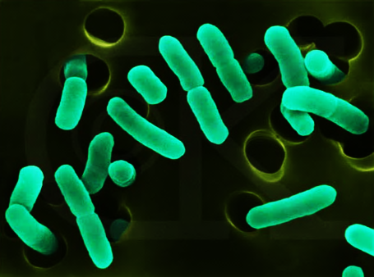
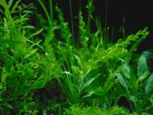
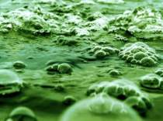
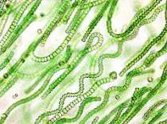
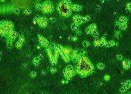
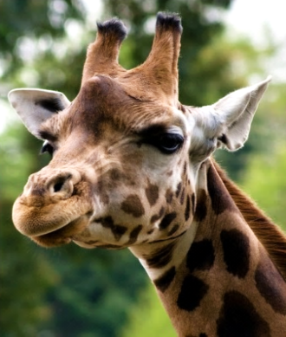

Photosynthesis is carried out by:
certain bacteria
plants
These organisms are known as photoautotrophs or producers meaning they make their own food and energy from the sun.
most algae
cyanobacteria
phytoplankton
Consumers such as herbivores and carnivores depend on the products of photosynthesis that producers make to live.

Slide 51

Photosynthesis takes place in:
  Thylakoid membrane– light-dependent phase
  Stroma – Calvin cycle phase
The main structures needed for photosynthesis are
    pigments called chlorophylls that are present in the thylakoid membrane of the chloroplast. These pigments are clustered into photosystems.
    Stomata: the structure of the leaf that allows gas exchange (CO2 enters, O2 exits during photosynthesis) and water evaporation

Slide 52

  Reactions of Photosynthesis
Photosynthesis is composed of two processes:
1. The light reactions:
Occur in the grana
Split water and releases oxygen
convert solar energy to chemical energy (ATP & NADPH).
2. The Calvin cycle: CO2 fixation
makes sugar from carbon dioxide.
Occurs in the stroma
Forms sugar from carbon dioxide, using ATP for energy, and NADPH as reducing power

Slide 53

Photosynthetic Pigments: The Light Receptors
Are substances that absorb visible light
Reflect light, which includes the colors we see
Chloroplasts contain several pigments:
Chlorophyll a: Is the main photosynthetic pigment
Chlorophyll b: Is an accessory pigment
Carotenoids: An accessory pigment (protective)

Slide 54
Photosystems
The pigments are organized into groups called Photosystems.
Composed of a protein complex called a reaction centre complex (Light-harvesting complex)
Light harvesting complex: Consists of various pigments molecules (chlorophyll a, b, & carotenoid)
Two photosystems:
  Water-splitting photosystem (P680 or Photosystem II)
  NADPH-producing photosystem (P700 or Photosystem I)

Slide 55
Photosystem II
The energy absorbed by the chlorophyll during the light reactions is used to make electrons “jump” out of the pigment’s atom and break the bonds of water absorbed through the plant’s roots.
  Water is here to help and donate its own electron to the pigment; as a result H2O molecule is split into electrons, protons (H+) and O2;
  O2 is a waste that will be released into the atmosphere.
  The “lost” electron has to be replaced in the pigment’s atom by another electron from water.
Then, the electron moves through a chain of proteins called electron transport chain (ETC).

Slide 56


Slide 57
ATP synthesis by PSII
As the electron moves, its energy is used by the proteins in the ETC to transport H+ from the chloroplast inside the thylakoid.
As a result there will be more H+ inside the thylakoid space than outside of it;
This difference in concentration triggers H+ movement through diffusion from the HIGH concentration (inside the thylakoid) to LOW (stroma).
H+ will move back into the chloroplast stroma through the ATP-synthase protein which will make ATP (!) = chemical energy

Slide 58
PSI and production of NADPH
As the electron moves, its energy is used by the proteins in the ETC to transport H+ from the chloroplast inside the thylakoid.
PSI absorbs energy and loses an electron in a similar way with PSII.
Its lost electron is replaced by the electron from the PSII coming down from the ETC
PSI electron will eventually end up in a molecule called NADPH (!) = chemical energy.
Light-dependent reactions harness energy from the sun to produce ATP and NADPH. These energy-carrying molecules travel into the stroma where the Calvin cycle reactions take place
.

Slide 60
Calvin cycle (CO₂ fixation)
Named after Melvin Calvin (1911–1997)
Takes place in the stroma of the chloroplast
The cycle gets its energy to conduct the reaction via high-energy election from NADPH and ATP
The NADPH and ATP are two of the products of the light-dependent reactions
In the Calvin reaction, 6 CO2 molecules enter the cycle from the atmosphere. The CO2 molecules combine with 6, 5-carbon molecules. Result: 12, 3-carbon molecules.
Key step is the attachment of CO2 to RuBP (ribulose 1, 5 bisphosphate) to form PGA (3-phosphoglycerate)
Uses enzyme ribulose bisphosphate carboxylase/oxygenase or rubisco

Slide 61

Three Phases of Calvin Cycle
Carbon fixation
  RuBP + CO₂ → PGA (3-phosphoglycerate)
Reduction
  PGA is reduced to G3P (glyceraldehyde 3-phosphates)
Regeneration of RuBP
  PGA is used to regenerate RuBP
Output of Calvin Cycle
Glucose is not a direct product of the cycle
G3P a 3-carbon sugar is the direct product of the cycle
Used to form sucrose, a major transport sugar in plants
www.hu.edu.et
Ever to Excel!

